Slide 1
Urban Heat Island Effect
Technology Review
Krittin Kulrattanaruks, Lilac Hong, Lori Won, Yongqin Zhao
CSE 583, 2023/11/14

Slide 2
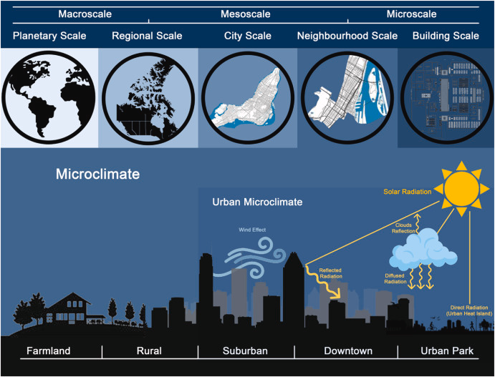
Background
Urban Constructions, buildings, etc. rise local climate changes problems, like heat-island.
How buildings would impact local microclimate? We want to study the correlation between urban built environment and microclimate.
There have been researches on field measurement, wind tunnel, simulation, ect. And in this project, we want to employ a ML way to help predict how a building project can impact the microclimate.
Specifically, how buildings would affect temperature, in different times of a year, at fine spatial resolution.
Orlanski, Isidoro. "A rational subdivision of scales for atmospheric processes." Bulletin of the American Meteorological Society (1975): 527-530.
Yang, Senwen, Liangzhu Leon Wang, Ted Stathopoulos, and Ahmed Moustafa Marey. "Urban microclimate and its impact on built environment–A review." Building and Environment (2023): 110334.

Slide 3
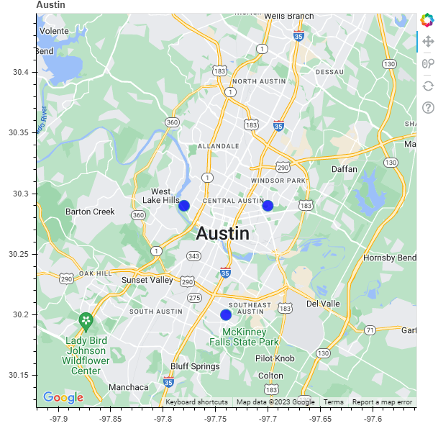
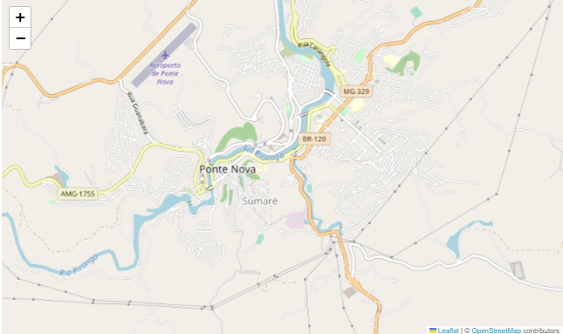
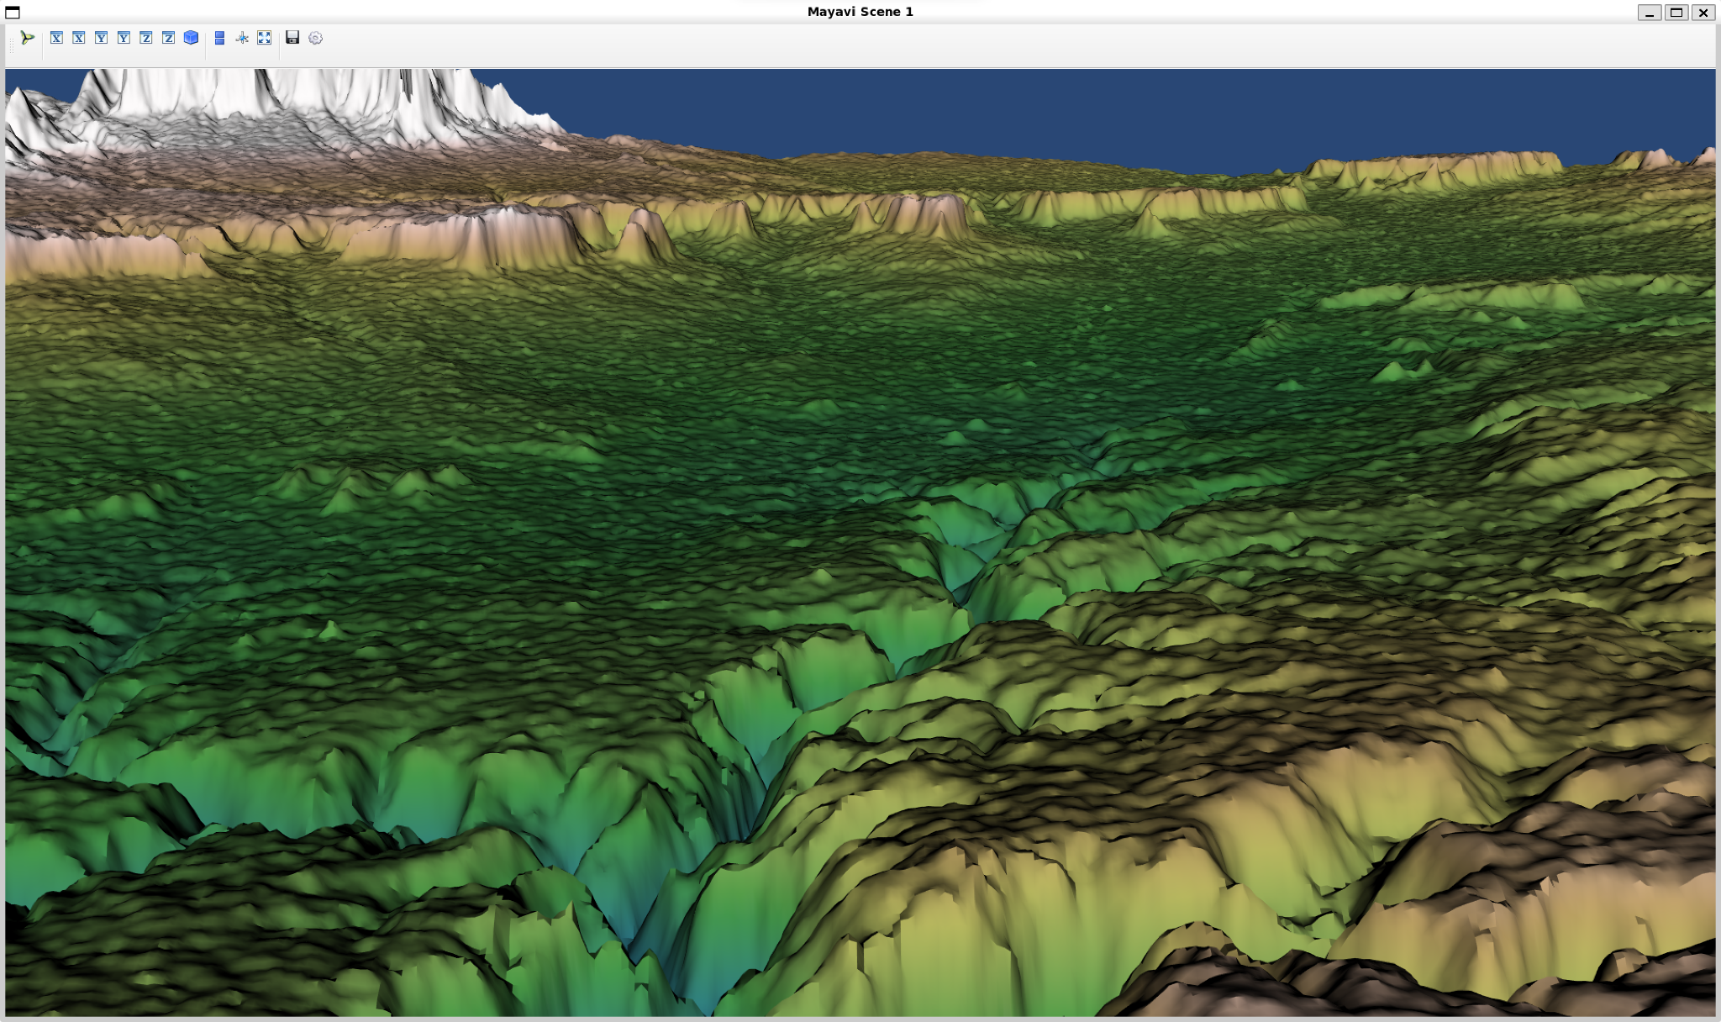
Considered Techs
Bokeh
Folium
Mayavi
Convenient user interface
Lots of useful functions
Creates topographical maps

Slide 4




Winner: Folium
What is it: Folium makes it easy to visualize data that’s been manipulated in Python on an interactive leaflet map. It enables both the binding of data to a map for choropleth visualizations as well as passing rich vector/raster/HTML visualizations as markers on the map.
How it works:
Creating a map & choosing a tileset: default built-in tileset is OpenStreetMap
Adding markers as well as a popup and tooltip
GeoJSON/TopoJSON overlays
Mapping tools
Data Analysis
Scientific Computing
Notes:
What is it: Folium makes it easy to visualize data that’s been manipulated in Python on an interactive leaflet map. It enables both the binding of data to a map for choropleth visualizations as well as passing rich vector/raster/HTML visualizations as markers on the map.

Slide 5
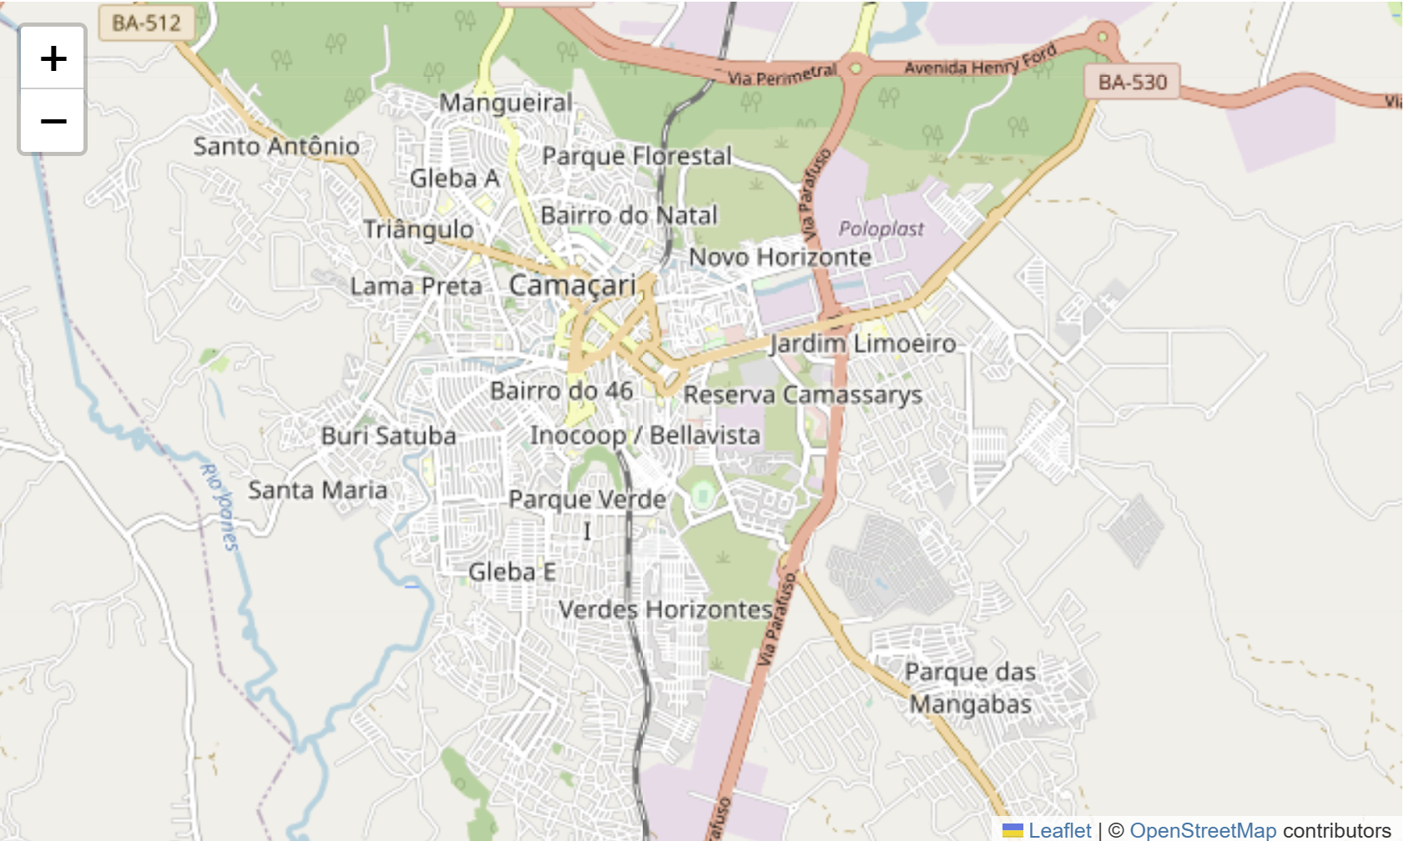
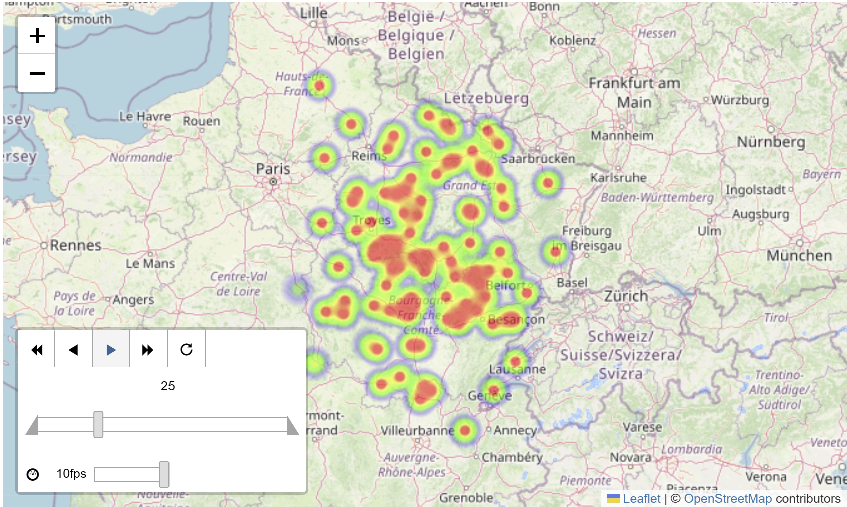
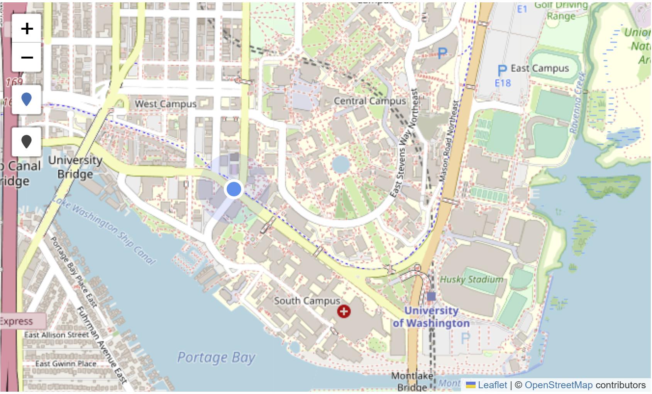
Why Folium?
Requirement:
Display general layout of the city
User Interactive (Coordinate input, zoom)
Able to add layers of data
Basic UI (Scale bar, Legend)
Able to work with large datasets

Slide 6
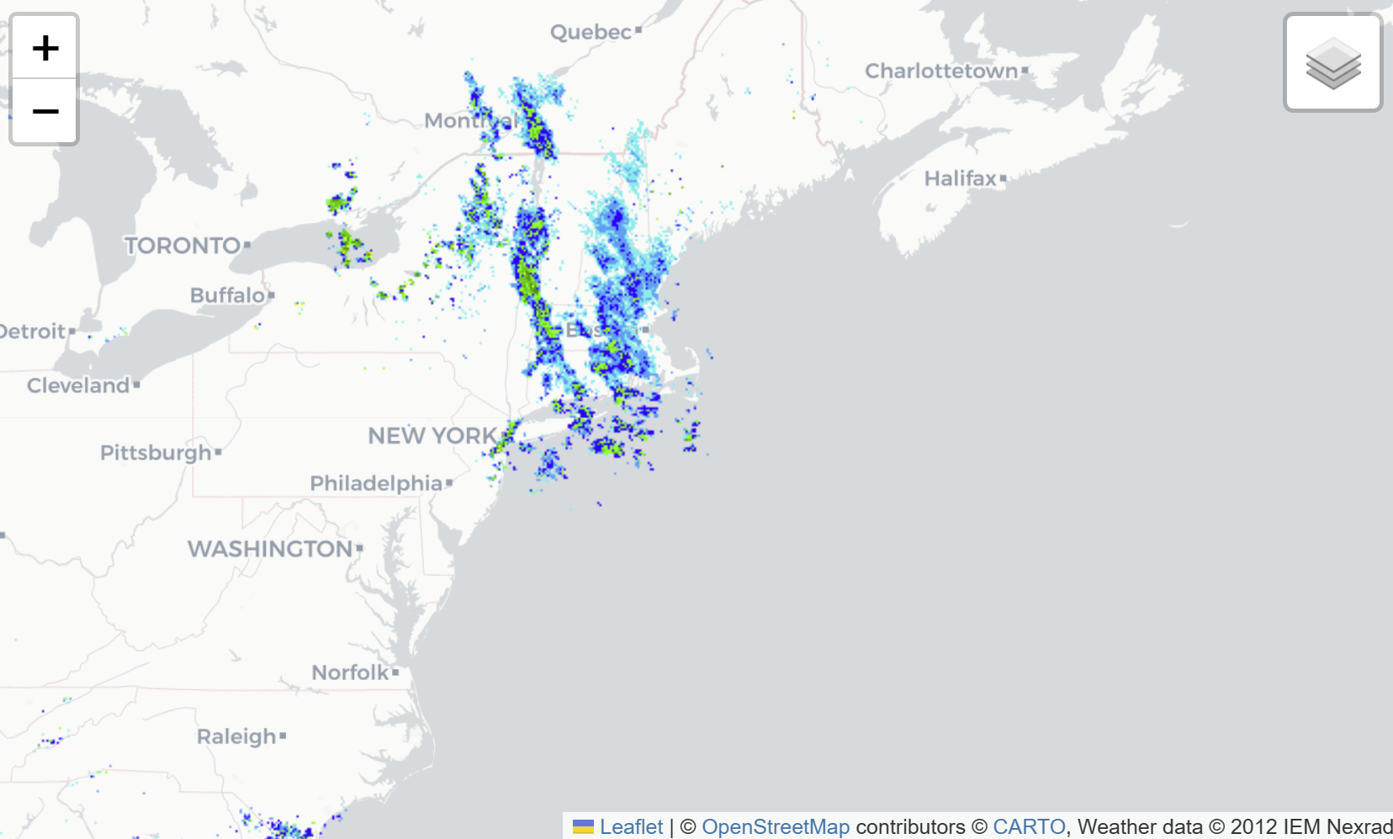
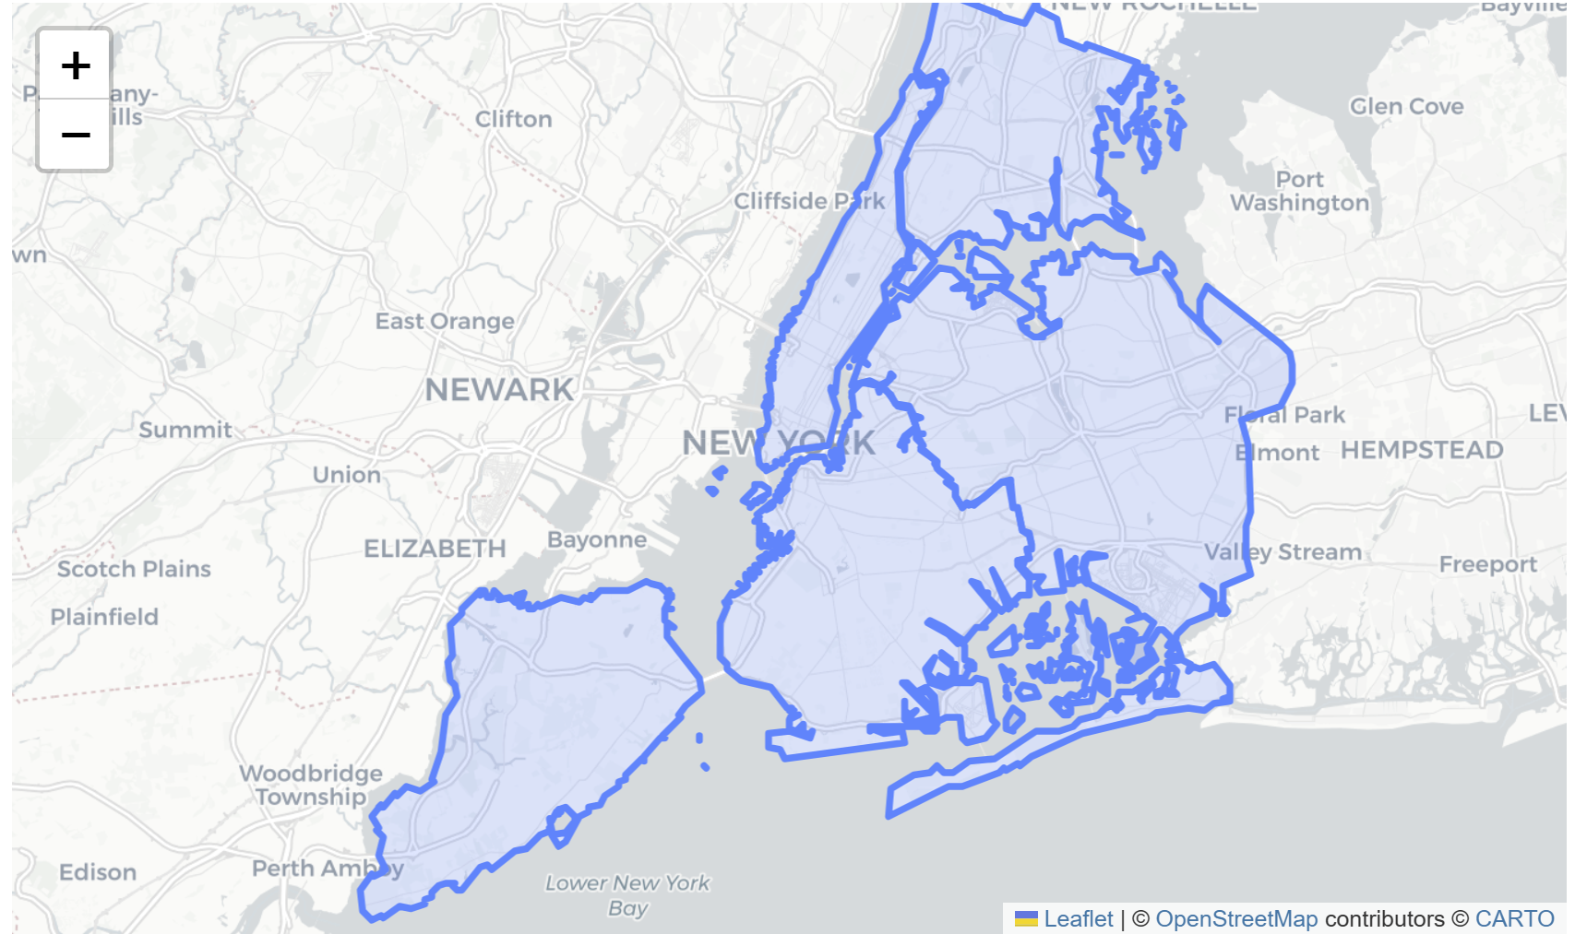
Why Folium? (Cont.)
Web Map Service (WMS) capabilities
.GeoJSON marker

Slide 7
Drawbacks
Performance with Large Datasets: Become slow to render and interact with when handling a large number of data points or layers.
Limited Interactive Features:The level of interactivity is somewhat limited compared to fully-featured web applications, e.g. unable to zoom into a specific location without placing a marker and obtain information
Dependence on Web Browsers: The interactivity and functionality are limited by the capabilities and compatibility of web browsers.

